Slide 1

SEARCH AND OPTIMIZATION
ALGORITHMS FOR
BINARY IMAGE COMPRESSION
- Reetu Hooda
Committee:
Dr. W. David Pan
Dr. B. Earl Wells
Dr. Seong-Moo Yoo
ECE Department
6th April 2018

Slide 2
Education
MS, Electrical Engineering
University of Alabama, Huntsville
(Aug 2016 – May 2018)
B.Tech, Electronics and Communication Engineering
Visvesvaraya Technological University, Karnataka (India)
(Sep 2012 – June 2016)

Slide 3
Outline
Introduction
Background
Block Scan Pattern Search using Binary Particle Swarm Optimization (BPSO)
Tree Based Search Algorithm
Simulation Results
Conclusion
Future Scope

Slide 4
Introduction
Background
BPSO
Tree-based algorithm
Results
Conclusions
Future scope
INTRODUCTION
Massive growth of image data.
This work focuses on improving the efficiency of lossless compression of binary images.
Main contribution of this work:
We propose the use of two optimization algorithms.
1. Binary particle swarm optimization (BPSO) algorithm which is shown
to offer increasingly better compression with additional iterations.
2. Tree-based search algorithm which searches for best grid structure for adaptively partitioning the image into blocks of varying sizes.

Slide 5
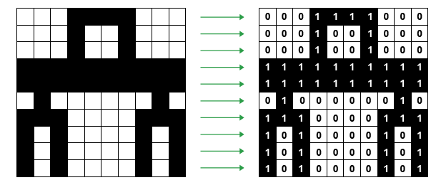
Introduction
Background
BPSO
Tree-based algorithm
Results
Conclusions
Future scope
OVERVIEW OF THE PROBLEM
Images contribute to huge part of data and information.
Advanced high-resolution cameras capture images with all the intricate details leading to big overall file size.
Storage and retrieval of data is challenging.
Digital image compression is concerned with efficient reduction of size of digital images.
We focus on Lossless Compression of Binary Images.
Binary image: either “0” or “1”.

Slide 6
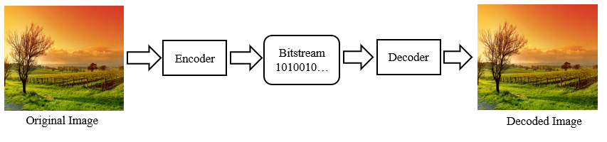
Introduction
Background
BPSO
Tree-based algorithm
Results
Conclusions
Future scope
APPROACHES
Outline
Insufficient storage and demand for higher transmission rates.
The images found on the web are compressed in some or other formats.
The compression techniques used on these images can be classified as:
Lossless Compression.
Lossy Compression.
A basic image compression algorithm:
Stores the image into a compressed bit-stream, in a way as compact as possible.
Decode the compressed bitstream to a reconstructed image as exact as possible to
the original image.

Slide 7
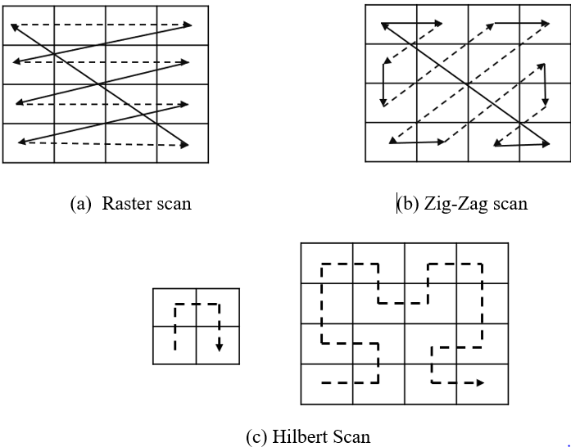
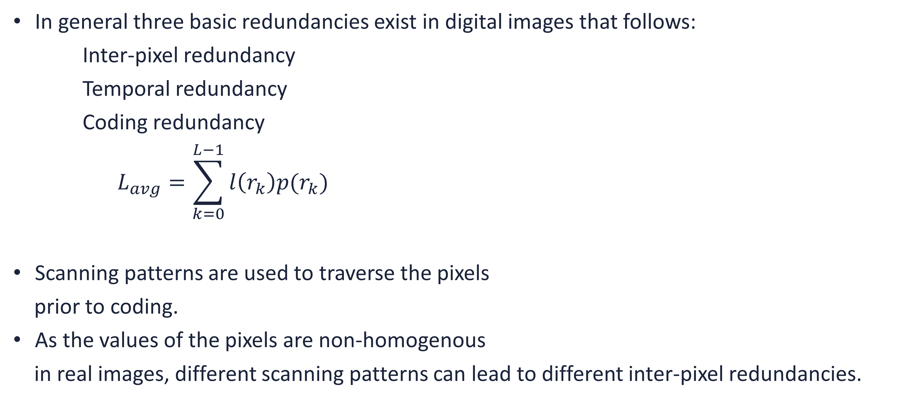
Introduction
Background
BPSO
Tree-based algorithm
Results
Conclusions
Future scope
REDUNDANCIES AND SCANNING PATTERNS
In general three basic redundancies exist in digital images that follows:
Inter-pixel redundancy
Temporal redundancy
Coding redundancy
$$L_{avg}=\sum_{k=0}^{L−1}{l\left(r_{k}\right)p(r_{k})}$$
Scanning patterns are used to traverse the pixels
prior to coding.
As the values of the pixels are non-homogenous
in real images, different scanning patterns can lead to different inter-pixel redundancies.

Slide 8
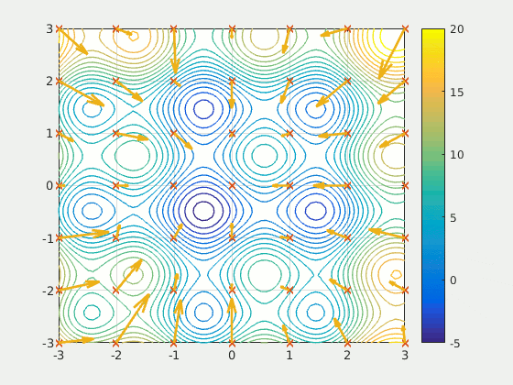
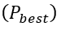
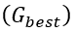
Introduction
Background
BPSO
Tree-based algorithm
Results
Conclusions
Future scope
Outline
OPTIMIZATION ALGORITHMS
Particle Swarm Optimization (PSO) is a metaheuristics optimization algorithm.
Simulates social behavior of the movement of an organism as a flock of birds or school of fish.
Each member of the swarm is called a “particle”.
Each particle represents a potential solution.
Particles fly around the search space with certain velocity till an optimum solution is found.
It is guided by:
Present location of the particle .
Personal experience .
Overall experience .

Slide 9
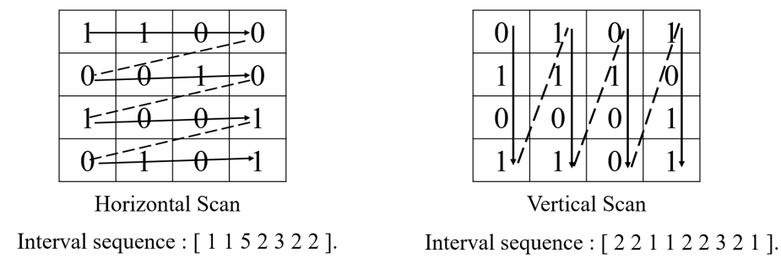
Introduction
Background
BPSO
Tree-based algorithm
Results
Conclusions
Future scope
Outline
BLOCK SCAN PATTERN SEARCH USING BPSO
BPSO: used to search for the best combination of scanning patterns used to traverse through the image blocks, generating interval sequences such that maximum compression is achieved.
The following scanning patterns are used:
Horizontal raster scan.
Vertical raster scan.
Direction bit : “1” for horizontal.
: “0” for vertical.
Interval Generations:
It calculates distance between the previous and next occurrence of the same binary symbol.
Problem of coding the original image Problem of coding the intervals.

Slide 10
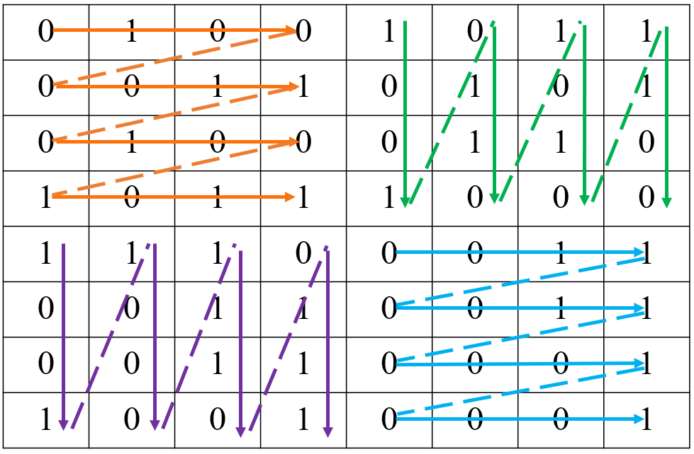
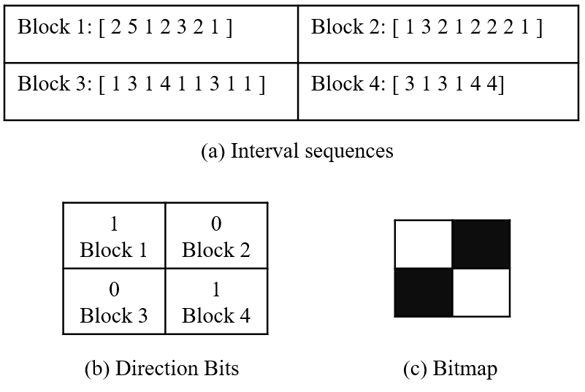
Introduction
Background
BPSO
Tree-based algorithm
Results
Conclusions
Future scope
OVERVIEW
Outline
An 8X8 image.
The image is divided into uniform sized blocks.
The scan paths for all the blocks are recorded as “Direction bits”.
The interval sequences are generated following a scan path.

Slide 11
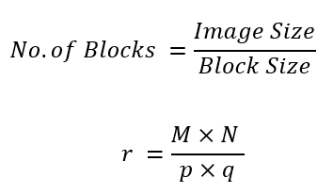
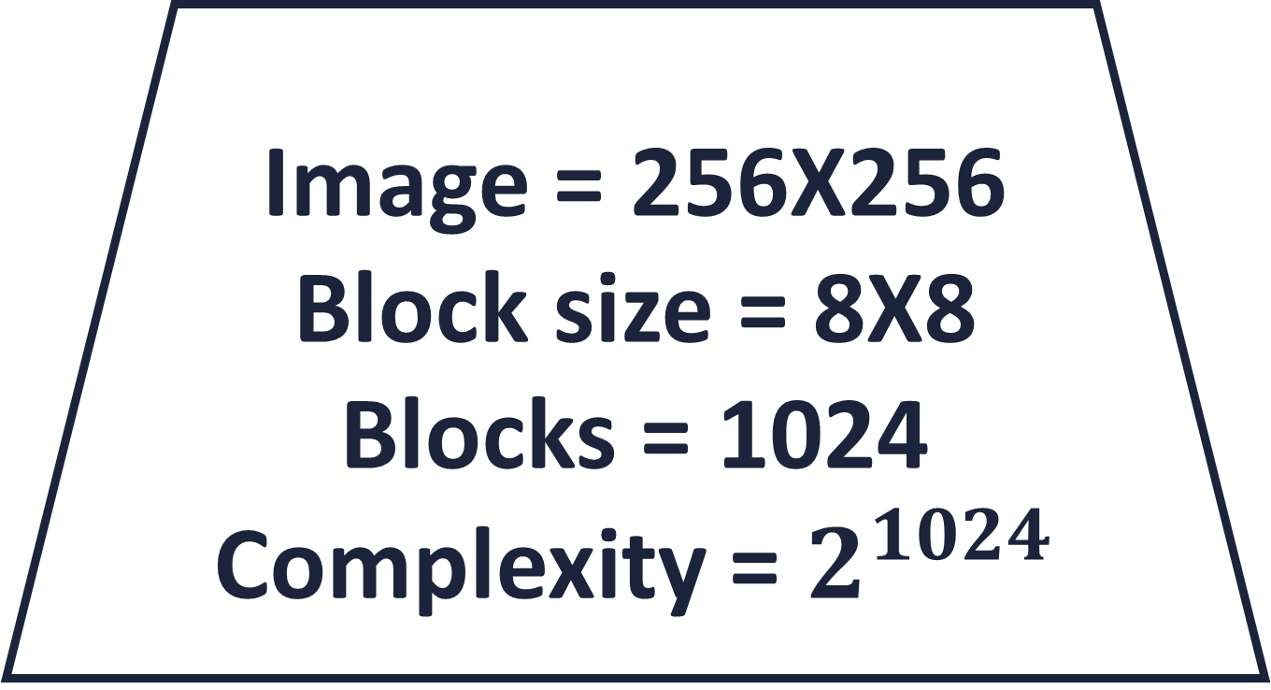
Introduction
Background
BPSO
Tree-based algorithm
Results
Conclusions
Future scope
ALGORITHM
As the no. of blocks , Search space , Dimension .
Complexity increases with # of blocks.
Role of BPSO: Search for the best solution in the huge search space of combination of block scanning directions.
Image = 256X256
Block size = 8X8
Blocks = 1024
Complexity = $2^{1024}$

Slide 12
Introduction
Background
BPSO
Tree-based algorithm
Results
Conclusions
Future scope
ALGORITHM
Parameter initialization:
Particles are initialized with a vector.
Block are scanned in two directions values in vector are
discrete.
Data structure of a particle:
Current position.
Best position so far.
Velocity of each particle.
Fitness value.

Slide 13
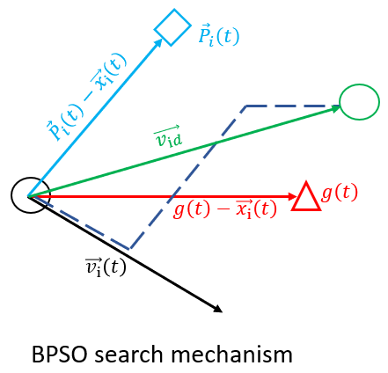
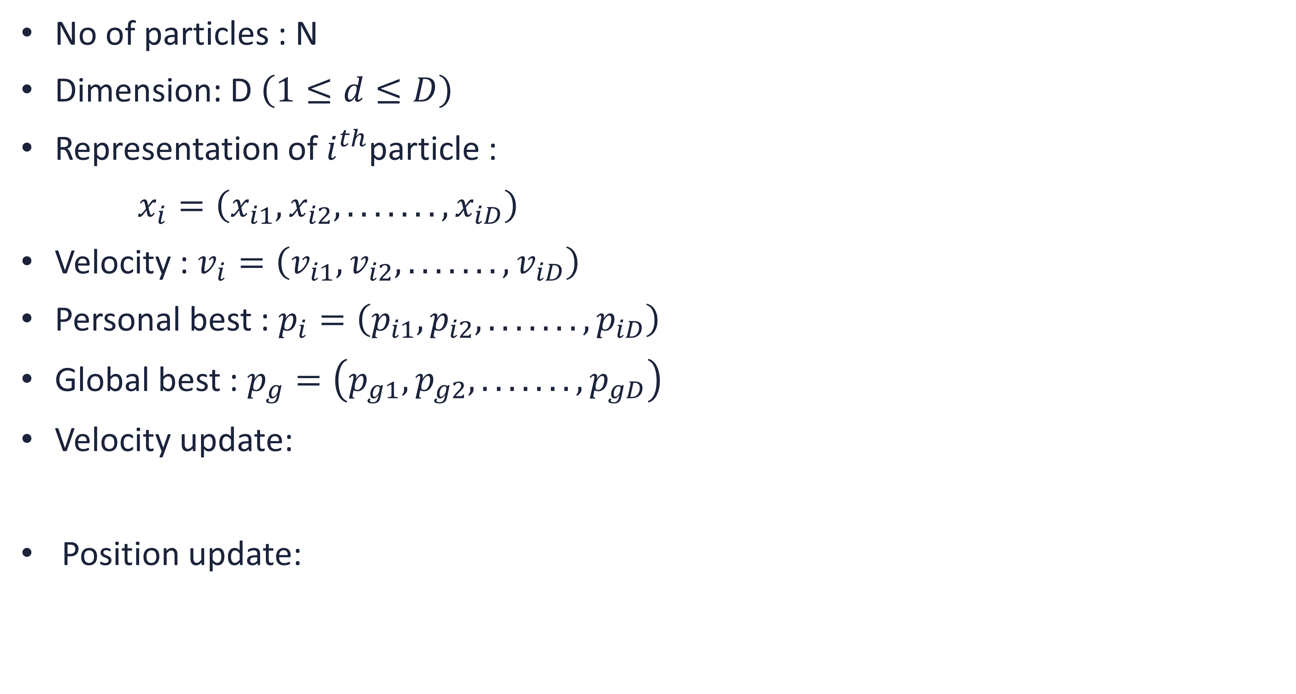
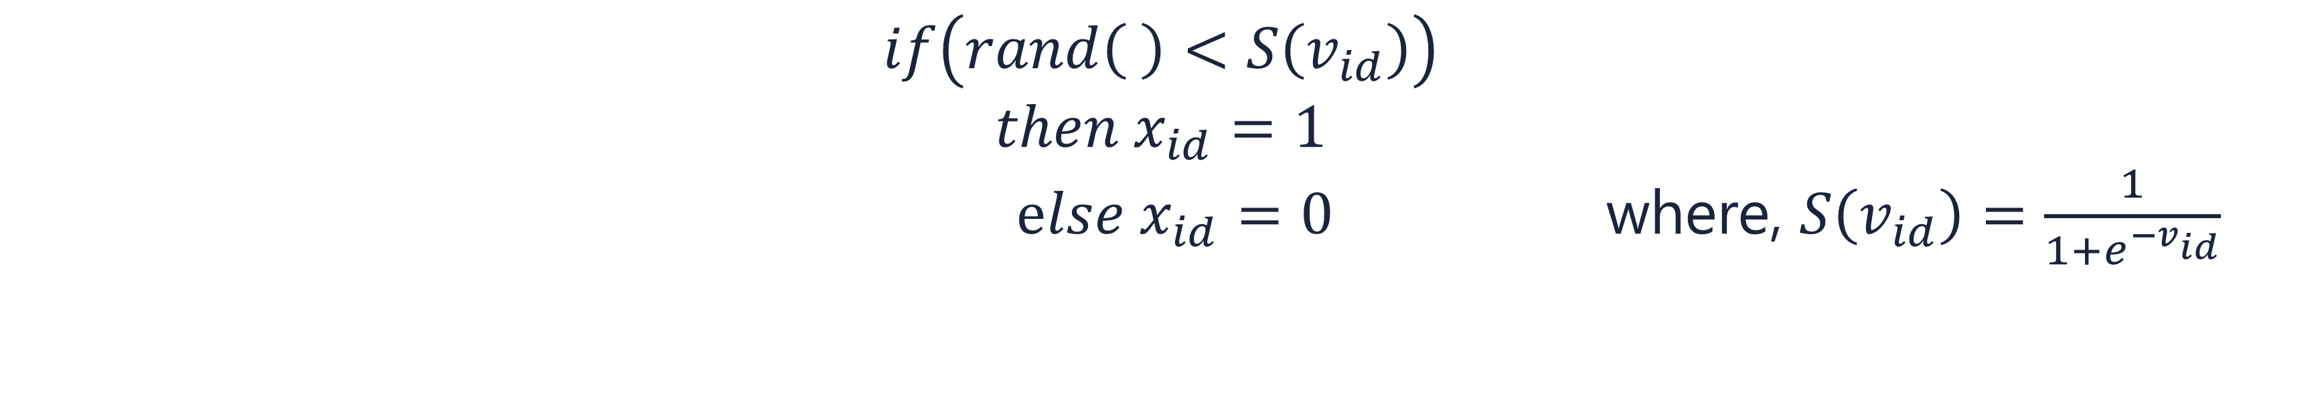
Introduction
Background
BPSO
Tree-based algorithm
Results
Conclusions
Future scope
Outline
BPSO MODEL
No of particles : N
Dimension: D $\left(1≤d≤D\right)$
Representation of $ⅈ^{th}$particle :
$x_{i}=\left(x_{i1},x_{i2},.......,x_{iD}\right)$
Velocity : $v_{i}=\left(v_{i1},v_{i2},.......,v_{iD}\right)$
Personal best : $p_{i}=\left(p_{i1},p_{i2},.......,p_{iD}\right)$
Global best : $p_{g}=\left(p_{g1},p_{g2},.......,p_{gD}\right)$
Velocity update:
Position update:
$$v_{id} = ωv_{id}+c_{1}r_{1}\left(p_{id}−x_{id}\right)+c_{2}r_{2}\left(p_{gd}−x_{id}\right)$$
$$if\left(rand\left( \right)<S\left(v_{id}\right)\right)$$
$$then x_{id}=1$$
$else x_{id}=0$where, $S\left(v_{id}\right)$ $=\frac{1}{1+e^{{−v}_{id}}}$

Slide 14
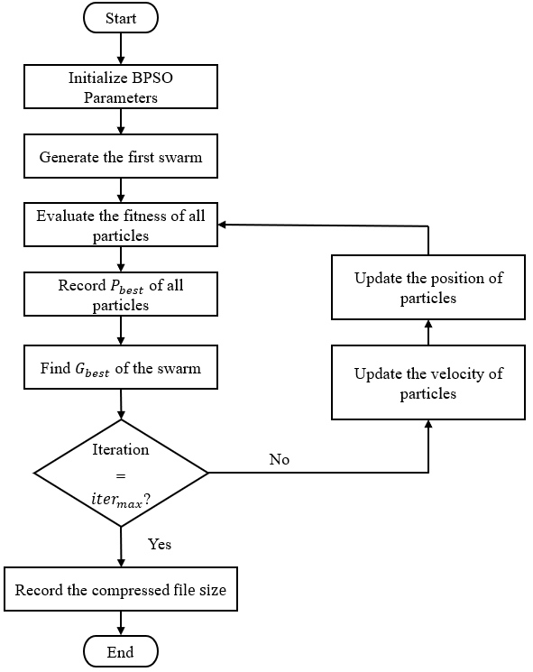
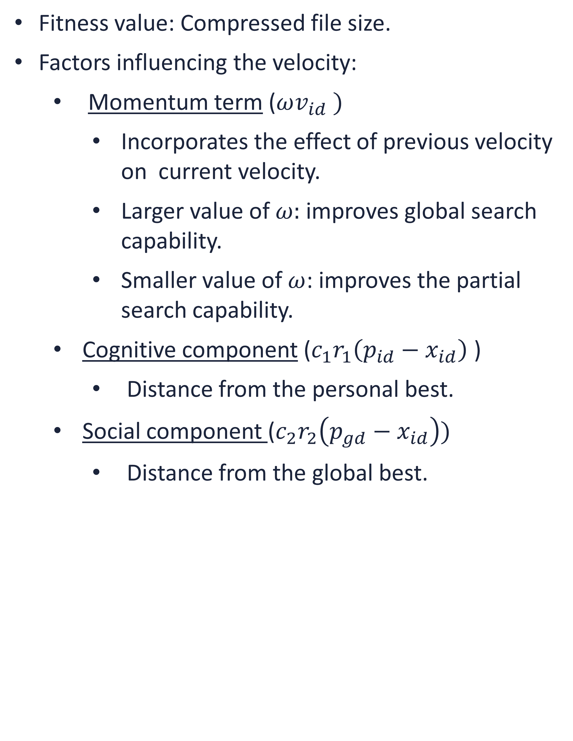
Introduction
Background
BPSO
Tree-based algorithm
Results
Conclusions
Future scope
FLOWCHART OF THE BPSO ALGORITHM
Fitness value: Compressed file size.
Factors influencing the velocity:
Momentum term ($ωv_{id} )$
Incorporates the effect of previous velocity on current velocity.
Larger value of $ω:$improves global search capability.
Smaller value of $ω$: improves the partial search capability.
Cognitive component ($c_{1}r_{1}\left(p_{id}−x_{id}\right)$ )
Distance from the personal best.
Social component ($c_{2}r_{2}\left(p_{gd}−x_{id}\right))$
Distance from the global best.

Slide 15
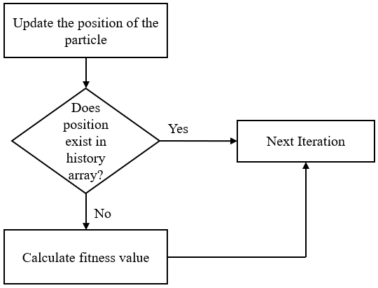
Introduction
Background
BPSO
Tree-based algorithm
Results
Conclusions
Future scope
Outline
PARTICLE HISTORY PRESERVATION
Involvement of random numbers causes evaluation of same solution, which affects computational complexity and time consumption.
Solution : Record history of all previously visited locations and its fitness values.
Avoids redundant fitness calculations.

Slide 16
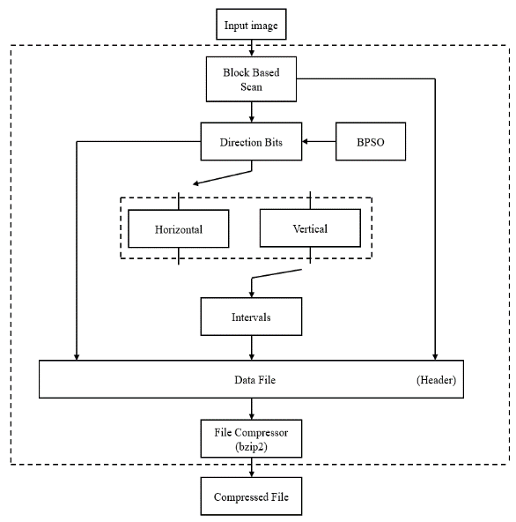
Introduction
Background
BPSO
Tree-based algorithm
Results
Conclusions
Future scope
Outline
FITNESS FUNCTION
Objective function : maps the search space to function space.
Maxima and minima of objective function: not directly known.
Different scanning path determines fitness value.
Fitness value determines the optimality of the set of parameters.
Data compression utility: bzip2
With every iteration new direction bits are generated.
Best fitness value : Global best.

Slide 17
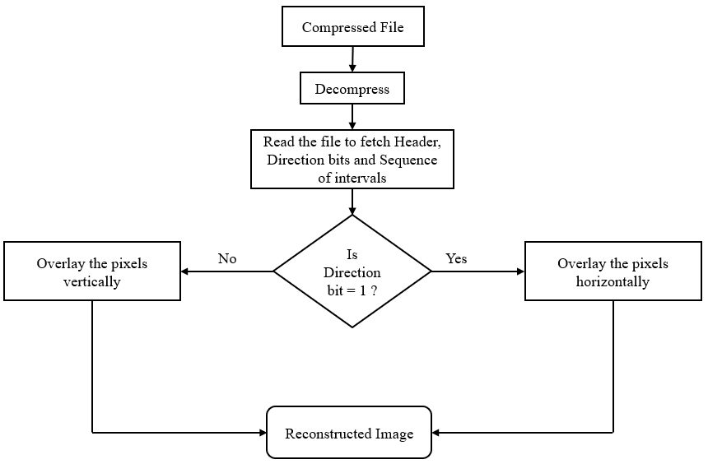
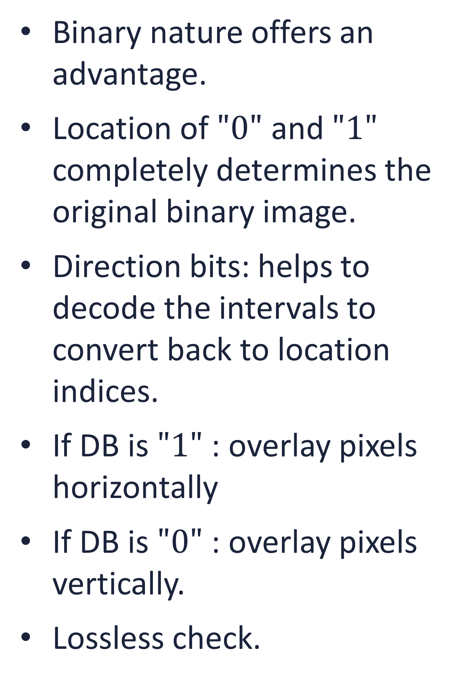
Introduction
Background
BPSO
Tree-based algorithm
Results
Conclusions
Future scope
Outline
DECODER
Binary nature offers an advantage.
Location of $"0"$ and $"1"$ completely determines the original binary image.
Direction bits: helps to decode the intervals to convert back to location indices.
If DB is $"1"$ : overlay pixels horizontally
If DB is $"0"$ : overlay pixels vertically.
Lossless check.

Slide 18
Introduction
Background
BPSO
Tree-based algorithm
Results
Conclusions
Future scope
Outline
TREE BASED SEARCH ALGORITHM
BPSO based search method is limited by the fixed block size.
Several regions of an image are less compressible than other regions.
Changing statistics of an image.
Exploiting the smoothness in portion of an image by splitting it into variable length segments.
Portions dominated by change : retained as smaller blocks.
Smooth segments : chosen not to be divided further.
Tree based algorithm steps:
a. Full search of image sub-blocks.
b. Optimal tree structure.
c. Two-level splitting of the original image.

Slide 19
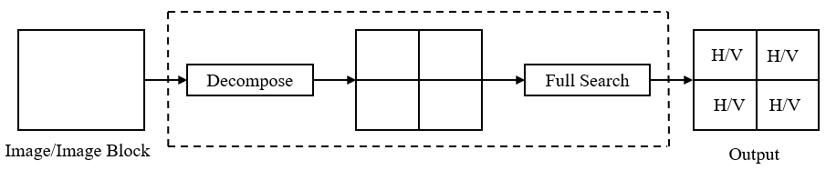
Introduction
Background
BPSO
Tree-based algorithm
Results
Conclusions
Future scope
Outline
FULL SEARCH OF IMAGE SUB-BLOCK
Full search : To examine the change in the amount of compression achieved.
Advantages : guarantees to explore all the search paths to solve a given problem.
High computational complexity difficult for real time implementation.
Operations:
Divide the image into 4 equally sized blocks
Find the best combination of scanning patterns.

Slide 20
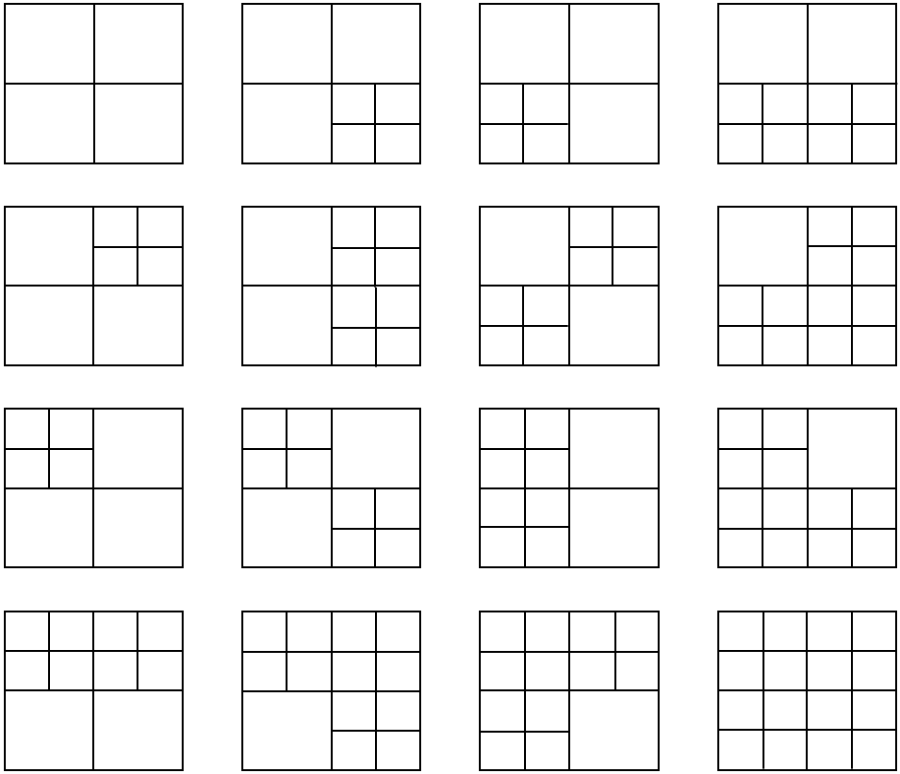
Introduction
Background
BPSO
Tree-based algorithm
Results
Conclusions
Future scope
Outline
ADAPTIVE GRID STRUCTURE
Content of an image regions contained in the image.
larger blocks for smooth regions
Smaller blocks for regions with largely varying content.
Binary decisions : full search performed on the sub-blocks.
Non-uniform areas: isolated from the remaining parts of the image.
There are total of 16 structures.

Slide 21
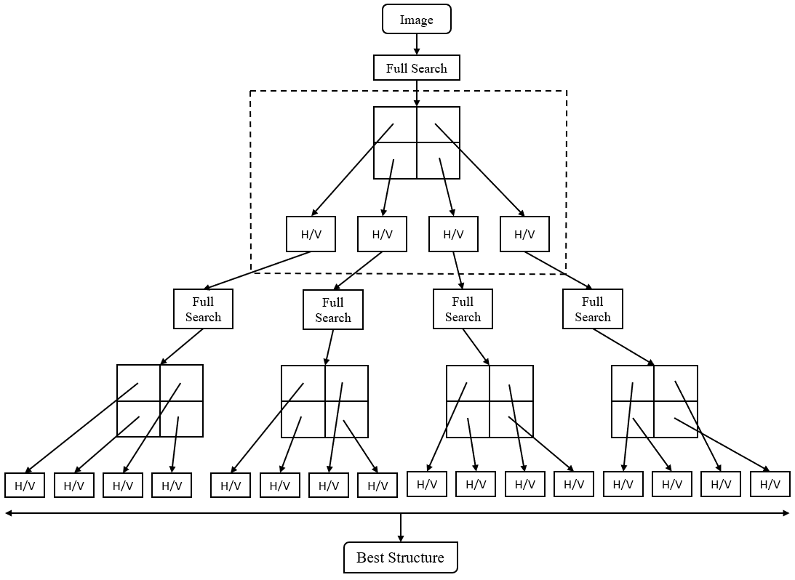
Introduction
Background
BPSO
Tree-based algorithm
Results
Conclusions
Future scope
Outline
TWO-LEVEL RECURSIVE SPLITTING
Computationally simple and very effective.
Image : “original tree” (root node).
Image can be represented by a tree structure.
Segmentation:
Performed iteratively.
Controlled at each step.
Split parent block child node.
Tree structure is designated by series of bits that indicate termination.

Slide 22
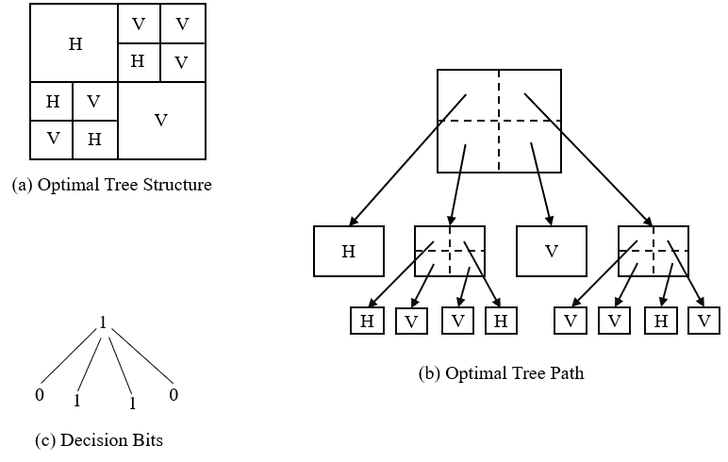
Introduction
Background
BPSO
Tree-based algorithm
Results
Conclusions
Future scope
Outline
FINAL STRUCTURE
Direction bits : represents division.
Each node has either no offspring or four offsprings.
If the block is divided :
Binary decision for selection
of scanning direction.
The procedure terminates after two-level recursive splitting.
Data file : Tree structure and sequence of intervals, header.
Final step: Data compression utility.
Lossless check.

Slide 23
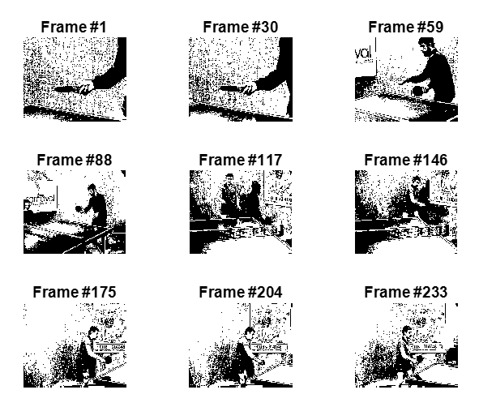
Introduction
Background
BPSO
Tree-based algorithm
Results
Conclusions
Future scope
SIMULATION RESULTS
Outline
Binary images were generated using thresholding from greyscale images.
Proposed algorithms were tested on several images datasets and compared with the following lossless compression schemes:
CCITT
FAX3
FAX4
JPEG 2000
JBIG2
Proposed method:
BSPO.
Tree-based search method.
Binary images obtained by thresholding greyscale images
from a video sequence

Slide 24
Introduction
Background
BPSO
Tree-based algorithm
Results
Conclusions
Future scope
SIMULATION RESULTS
The cost function value (the compressed file size) changes with each iteration.
No of iterations: 100 (for BPSO)
Reduction in compressed file size.
Unique (optimal) scan path at 100th iteration.
Bitmap: for viewing the scan directions of the blocks within an image.
“1”, i.e., white for horizontal scan and “0” for vertical scan.
Similar frames gives similar bitmaps:
Frame 204
Frame 233
The cost function value with each iteration

Slide 25
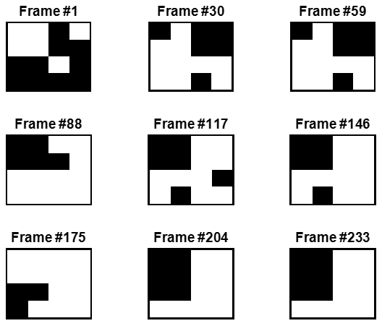
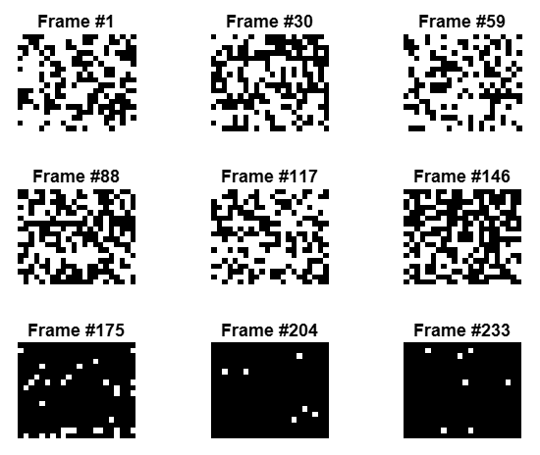
Introduction
Background
BPSO
Tree-based algorithm
Results
Conclusions
Future scope
BITMAPS
Bitmaps using Tree-based algorithm
Bitmaps using BPSO

Slide 26
Introduction
Background
BPSO
Tree-based algorithm
Results
Conclusions
Future scope
COMPARISON OF PROPOSED ALGORITHMS WITH OTHER
TECHNIQUES
Outline
Test image index 1, 2, 3, 4, 5, 6, 7, 8, and 9 refers to frame 1, 30, 59, 88, 117, 146, 175, 204, 233 in sequence, respectively.
BPSO provides significantly higher compression than other methods.
BPSO method has lower compression than JBIG2 standard method on average.
Tree-based search algorithm achieves highest compression for frame 5 to 9.
Compression results for the “Tennis” sequence

Slide 27
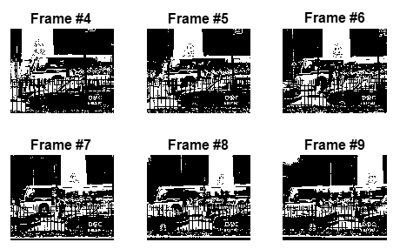
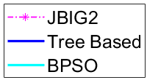
Introduction
Background
BPSO
Tree-based algorithm
Results
Conclusions
Future scope
Outline
“BUS” SEQUENCE
Binary images obtained from the “Bus” sequence.
Compression results for the “Bus” sequence.

Slide 28
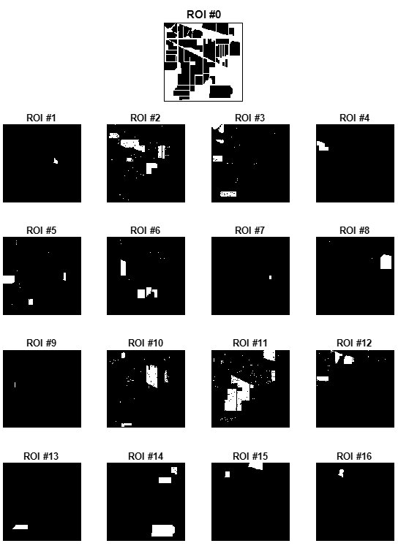
Introduction
Background
BPSO
Tree-based algorithm
Results
Conclusions
Future scope
Outline
HYPERSPECTRAL DATASET
“Indian Pine (IP)” hyperspectral
image dataset
Compression results of bi-level IP ROI maps.

Slide 29
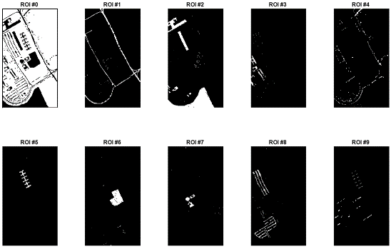
Introduction
Background
BPSO
Tree-based algorithm
Results
Conclusions
Future scope
“PAVIA UNIVERSITY” DATASET
“Pavia University (PU)” hyperspectral
image dataset
Compression results of bi-level PU ROI maps.

Slide 30
Introduction
Background
BPSO
Tree-based algorithm
Results
Conclusions
Future scope
Outline
CONCLUSION
We proposed two optimization and search methods for lossless compression of binary images.
BPSO is shown to offer increasingly better image compression with additional iterations.
The algorithm explores different search paths to reach the most optimal one.
We observed reduction in file size with every iteration resulting in improvement of compression.
Tree based search algorithm searches for best grid structure employing blocks of varying sizes.
Non-uniform block size exploits different regions of the image based on its intrinsic nature.
Extensive simulations showed that we can achieve higher compression on average.

Slide 31
Introduction
Background
BPSO
Tree-based algorithm
Results
Conclusions
Future scope
Outline
FUTURE EXPANSION
The proposed methods used two scan paths, hence operating in low-dimension space.
A general extension to this work could be to increase the number of scan paths to choose from, which will result in generating different interval sequences.
Alternatively, we can explore search paths using more advanced BPSO models.
In addition, the tree-based search scheme has only two levels which limits the scope of this research.
The two-level tree-based scheme can be extended to more levels, with the goal of increasing the compression significantly.

Slide 32
REFERENCES
Outline
L. Liaghati, and W. D. Pan, “An Adaptive Interval Generation Method for Efficient Distance Coding of Binary Images,” in Proc. of SPIE 9443, Sixth International Conference on Graphic and Image Processing (ICGIP 2014), March 2015.
H. Shen, W. D. Pan, Y. Dong, and Z. Jiang, “Golomb-Rice Coding Parameter Learning Using Deep Belief Network for Hyperspectral Image Compression,” in Proc. of IEEE International Geoscience and Remote Sensing Symposium (IGARSS), Fort Worth, TX, July 2017.
J. Kennedy and R. C. Eberhart, “Particle Swarm Optimization,” in Proceedings of the IEEE International Conference on Neural Networks, vol. 4, Perth, Australia, 1995.
J. Kennedy and R. C. Eberhart, “A Discrete Binary Version of the Particle Swarm Algorithm,” in Proceedings of the IEEE Conference on Systems, Man, and Cybernetics, pp. 4104–4109, 1997.
J. Cai and W. D. Pan, “On Fast and Accurate Block Based Motion Estimation Algorithms Using Particle Swarm Optimization,” Information Sciences, vol. 197, pp. 53-64, August 2012.
A. L. Liaghati, H. Shen, and W. D. Pan, “An Efficient Method for Lossless Compression of Bi-Level ROI Maps of Hyperspectral Images,” in Proc. of IEEE Aerospace Conference, Big Sky, Montana, March 2016.

Slide 33
Thank You!
Any questions?

